Slide 1


Project Management Framework and Tools
The Absolute Basics

Slide 2

What is a Project
A temporary endeavor undertaken to create a unique result within a given time
Building a house
Planning a wedding
Developing a new vaccine

Slide 3
Management
Application of knowledge, skills, tools and techniques to meet goals and requirements on an ongoing basis
Leading an IT team
Parenting a family
Running a company or department

Slide 4
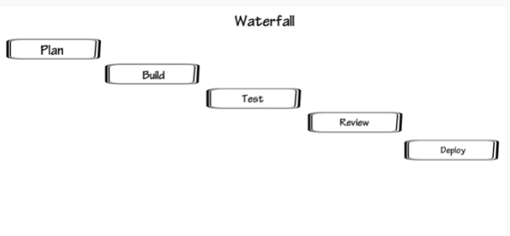
The Waterfall method
This approach was called Waterfall due to its design of cascading of activities in phases, starting from planning, building, testing, reviewing and deploying

Slide 5
The Waterfall method
Advantages:
Easy to manage
Faster delivery
Progress is easily measured
Hands off approach
Budget is set

Slide 6
The Waterfall method
Disadvantages:
Little room for changes
Inflexible
Time bound
Less customer involvement
No product until the end

Slide 7
What is Agile?
Agile - The ability to create and respond to change in order to succeed in an uncertain and turbulent environment.
Agile methodology is a structured and iterative approach to project management and product development, most commonly used for software.

Slide 8
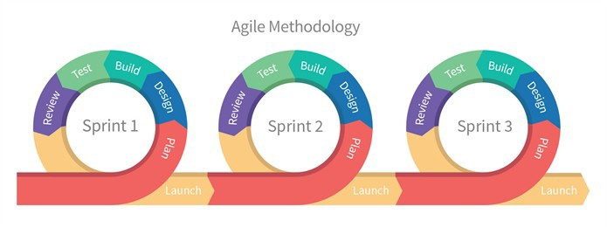
How Agile Works
Iteration is the repetition of a process in order to generate an outcome.
Unlike traditional Waterfall approach, the Agile methodologies follow an iterative approach. The agile approach basically involves a number of cycles usually called sprints that are designed, developed and tested individually.
Simply, consider each sprint to be a miniature project having its own design, development, testing, backlog and deployment phases within the pre-defined scope of work.

Slide 9
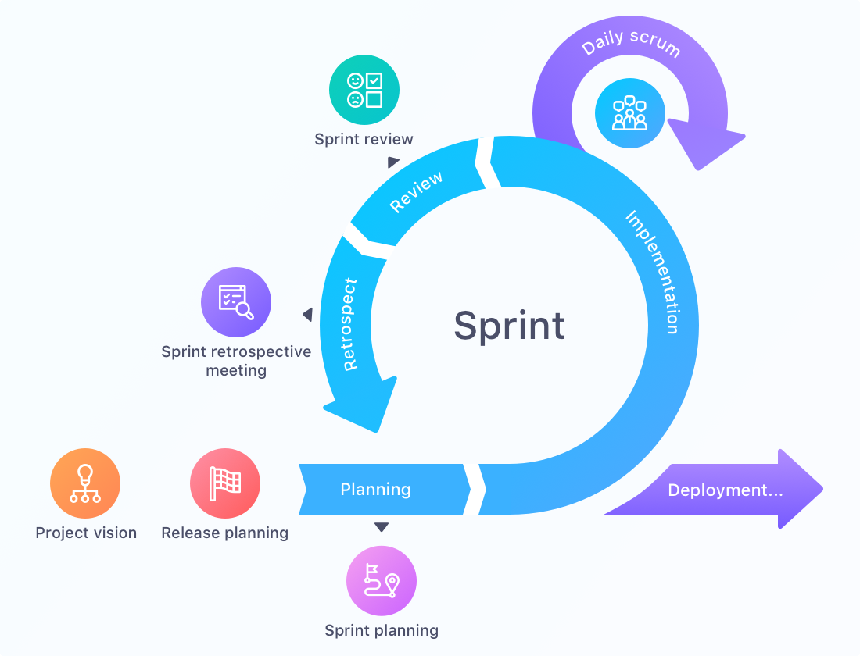
SPRINT
Each sprint defines a time-boxed phase with a defined duration of two weeks.
At the start of each sprint, a list of deliverables are prioritized based on customer input.
At the end of the sprint, the team and the customer review and evaluate the work with notes for future sprints.

Slide 10
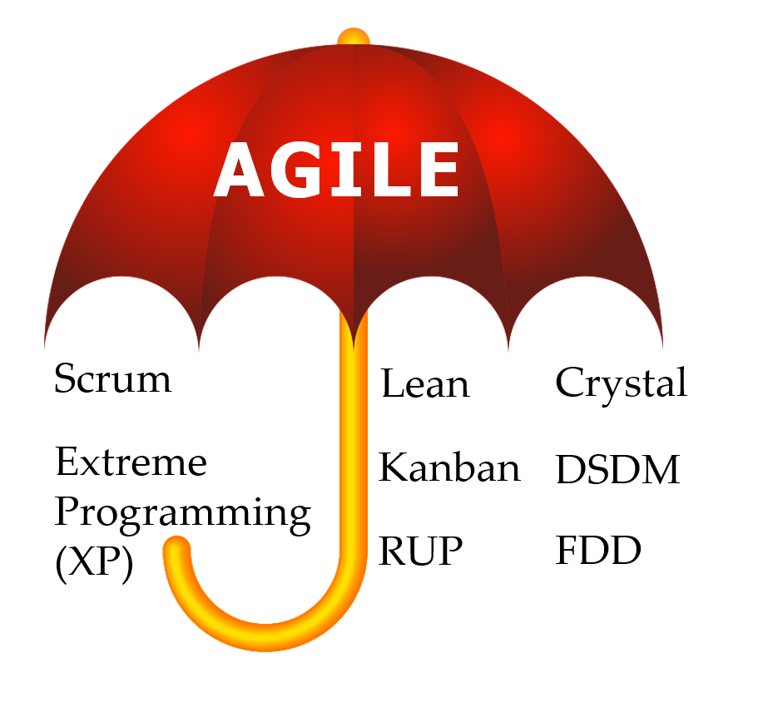
The Agile Frameworks
Gantt Chart

Slide 11
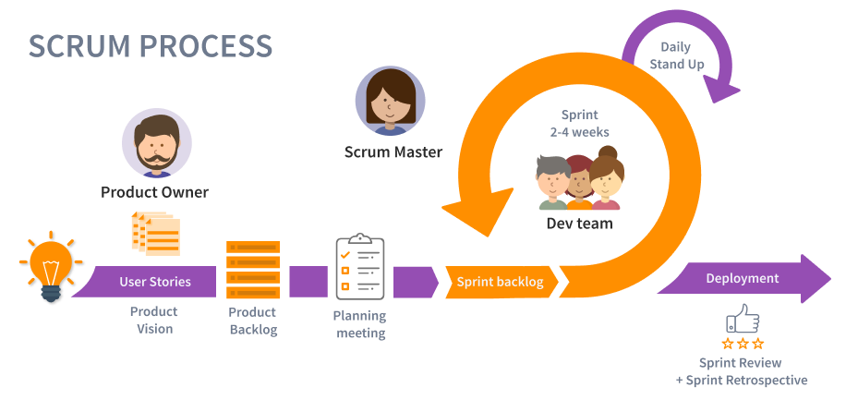

Slide 12

ROLES
EVENTS
ARTIFACTS

Slide 13
Scrum Roles
The Agile Scrum method defines 3 roles. They are all complementary and it’s important to understand each one’s responsibilities.
ROLES:
Scrum Master
The Scrum Master leads the daily Scrums and helps resolve issues or remove blockers so that the team can continue to perform well during the sprint.
Product Owner
The person responsible for maximizing the value of the work completed by the Development Team. One way they do this is by managing the Backlog.
Development Team
A small group of people who are ultimately working on The Thing. The team can be multidisciplinary and involve several types of people: developers, software architects, functional analysts, graphic designers, ergonomists, systems engineers, etc.

Slide 14
Scrum Events and Artifacts
Backlog - Prioritized features list, containing short descriptions of all functionality desired in the product.
Product Review Meeting - Held at the end of each sprint. The Scrum team shows what they accomplished during the sprint. Typically this takes the form of a demo of the new features.
Sprint Backlog - A list of tasks identified by the Scrum team to be completed during the Scrum sprint.
User Stories
Planning Meeting - Held at the beginning of every sprint to develop realistic Sprint backlog and define the highest priority tasks which need to be done during the length of each Sprint.
Daily Stand Up (Scrum) - Short 15 minutes meetings which occur on daily basis. Typically held at the same time and same place every day and no longer than 15 minutes. Discussion to stay light, relevant, and quick.
Deployment - Usually it is the release of the product. It can be the final product or the Minimum Viable Product (at the end of a Sprint)

Slide 15
Key Scrum Meetings
Daily Scrum
The daily Scrum, also called the standup, or daily standup is a short daily meeting designed to let the team plan out its work for the day and identify any obstacles that could impact that work.
Most teams hold these meetings in the morning and limit them to 10 or 15 minutes. They are sometimes called standups because many teams hold them standing up to keep them short and focused.
Sprint Planning
It is a team meeting held before the next agile sprint. During sprint planning, the team reviews its backlog and decides what items to prioritize for the next sprint.
Sprint Retrospective
It is a post-sprint discussion. The Scrum team reviews what happened during the sprint to determine what worked, what didn’t work, and how they can improve the process during the next sprint.

Slide 16
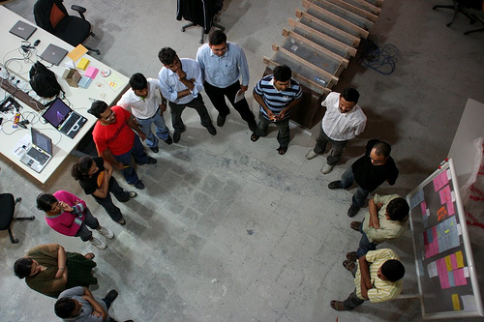
Daily Scrum
aka Daily Stand-up
Agile Teams of 6 to 8 people
10 minutes first thing in the morning
Three questions participants should ask each other during a daily stand-up:
What did I accomplish yesterday?
What will I accomplish today?
What obstacles are impeding my progress?
Notes:
Explain to participants that starting tomorrow, they will begin each morning (10 minutes) with Daily Stand-ups for the remainder of the program.

Slide 17
Learning Activity #1: What is a workplace impediment?
Statement | Yes or No?
I’m unable to complete the project task because I don’t understand the material
I couldn’t study because the material was too boring
My team member is sick preventing the project from moving forward
I’m having issues with time management
I have been procrastinating which has prevented me from getting my tasks done
Unplanned events (i.e site tours/guest speakers) have prevented me from getting work completed
My laptop/computer is broken and I was unable to study
My laptop/computer is broken and I was unable to complete the project task
There are members of the team who are absent
An impediment is anything that slows down or diminishes the pace of the Team.
Based on the list on the right, spend some time in your team to identify whether each statement is an impediment or not and why your team thinks it may or may not be considered one
Notes:
What do you think is reasonable to call and tell your manager?
An impediment is anything that is slowing down the Team. (The Agile-Scrum Team) Anything!
Even though we can not solve the impediment, we can almost always mitigate its impacts on us.

Slide 18


Learning Activity #1: What is a workplace impediment?
Statement | Yes or No?
I’m unable to complete the project task because I don’t understand the material
I couldn’t study because the material was too boring
My team member is sick preventing the project from moving forward
I’m having issues with time management
I have been procrastinating which has prevented me from getting my tasks done
Unplanned events (i.e site tours/guest speakers) have prevented me from getting work completed
My laptop/computer is broken and I was unable to study
My laptop/computer is broken and I was unable to complete the project task
There are members of the team who are absent
An impediment is anything that slows down or diminishes the pace of the Team.
Notes:
What do you think is reasonable to call and tell your manager?
An impediment is anything that is slowing down the Team. (The Agile-Scrum Team) Anything!
Even though we can not solve the impediment, we can almost always mitigate its impacts on us.

Slide 19
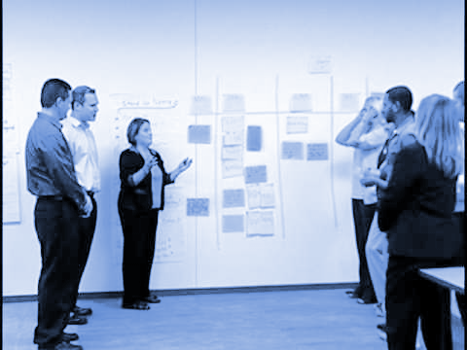
What Daily Scrum is NOT
The stand-up meeting is not a status or recording meeting (excluding the Scribe).
The stand-up meeting is not for micromanagement.
The stand-up meeting is not only for the Scrum Master.
The stand-up meeting is not a planning meeting.
The stand-up meeting is not a technical discussion.
The stand-up meeting must consist of the three questions.
https://www.scrumalliance.org/community/articles/2014/july/7-mistakes-during-the-daily-stand-up-meeting

Slide 20
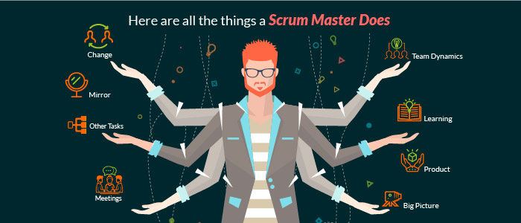
What is a Scrum Master?
Not the boss but a facilitator
Leads Daily Scrum
Protects and encourages the team
Removes impediments of the team
Provides performance updates and communicates with Project Managers of any setbacks affecting team
Notes:
Go in your breakout rooms:(10 minutes)
Vote for the scrum master
Vote for the scribe
Choose a team name
Submit on schoology, under scrum master report link

Slide 21
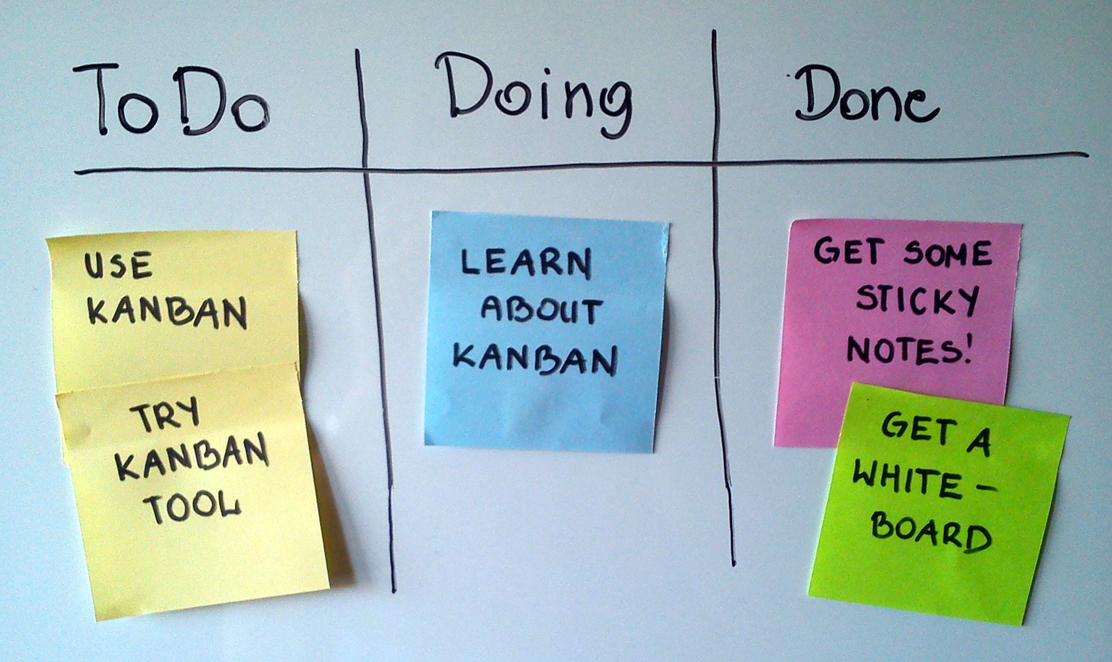

Kanban
Kanban is a popular framework used by teams practicing agile software development but now commonly used in varying practices.
Notes:
END

Slide 22
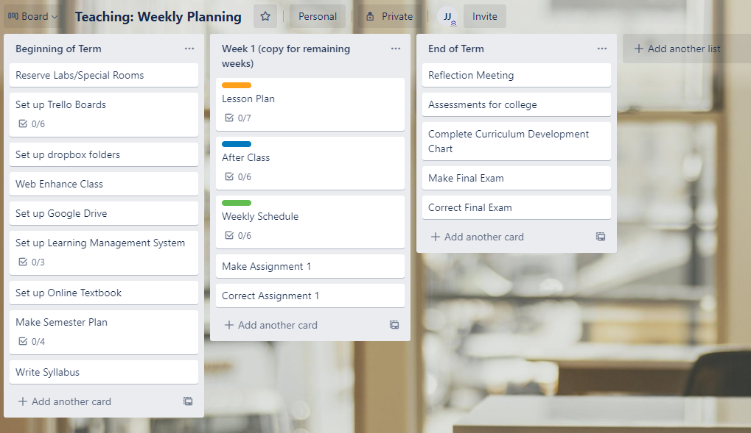
Trello board
Notes:
Go to the breakout rooms:
Only Scrum master will create a Kanban board for the team under https://trello.com/
Create a board and add everyone’s email + share with instructor also

Slide 23
The End
This course offers a very brief overview of project management which is intended to give you a basic understanding if and when confronted with the subject.
For a good video on Project Management please follow this link: https://www.youtube.com/watch?v=6LJLIfRfrts

